Slide 1
Data Center Infrastructure CT109-3-2&Version 2
IT Hardware

Slide 2
Topic & Structure of The Lesson
IT Hardware

Slide 3
Learning Outcomes
At the end of this topic, YOU should be able to:
Identify the roles and terminologies of servers.
Understand the issues surrounding low server utilisation and the benefits of virtualisation.
Understand the various types of storage equipment.
Understand the various types of communications equipment.
Be aware of technology developments, today’s challenges and the associated standards & regulations around IT hardware

Slide 4
Key Terms You Must Be Able To Use
If you have mastered this topic, you should be able to use the following terms correctly in your assignments and exams:
NAS
DAS
SAN
FCoE

Slide 5
Network Hardware
Active network components are electronic systems that are required to amplify, convert, identify, control and forward streams of data. Network devices are a prerequisite for computer workstations being able to communicate with one another, so they can send, receive and understand data.

Slide 6
Client/Server network
A Client/Server network differentiates between two types of computers that make up the network: The server, as host, is a computer which provides resources and functions to individual users from a central location; the client, as customer, takes advantage of these services. The services provided by servers are quite diverse: They range from simple file servers which distribute files over the network or
release disk space for other uses, to printer servers, mail servers and other communication servers, up to specialized services like database or application servers.

Slide 7
Peer-to-Peer Network
As its name implies, a Peer-to-Peer Network consists principally of workstations with equal rights. Every user is able to release the resources from his/her own computer to other users in the network. This means that all computers in the network, to a certain extent, provide server services. In turn, this also means that data cannot be stored in one central location.

Slide 8
IT Infrastructure Basics
Active components, if they are network-compatible, have LAN interfaces of various types. These are specified by the technology used for the transmission (transmission protocol, e.g. Ethernet), speed (100 Mbit/s, 1/10 Gbit/s), media support (MM/SM, copper/fiber) and interface for the physical connection (RJ45, LC, etc.).
There are two types of latencies (delay) in the transmission of data for network-compatible devices:
· Transfer delay (in μs/ns, based upon medium and distance)
· Switching delay (in ms/μs, based upon device function, switching/routing)

Slide 9
Server (Single Server)
Server as software:
A server is a program which provides a service. In the context of the client/server model, another program, the client, can use this service. Clients and servers can run as programs on different computers or on the same computer.
In general, the concept can be extended to mean a group of servers which provide a group of services. Examples are mail servers, (extended) web servers, application servers and database servers.

Slide 10
Server as hardware:
The term server for hardware is used…
· …as a term for a computer on which a server program or a group of server programs run and provide basic services, as already described above.
· …as a term for a computer whose hardware is adapted specifically to server applications, partly through specific performance features (e.g. higher I/O throughput, higher RAM, numerous CPUs, high reliability, but minimal graphics performance).

Slide 11
Server Farm
A server farm is a group of networked server hosts that are all of the same kind and connected to one logical system. It optimizes internal processes by distributing the load over the individual servers, and speeds up computer processes by taking advantage of the computing power of multiple servers. A server farm uses appropriate software for the load distribution.

Slide 12
Virtual Server
If the performance provided by a single host is not enough to manage the tasks of a server, several hosts can be interconnected into one group, also called a computer cluster. This is done by installing a software component on all hosts, which causes this cluster to appear as a single server to its clients. Which host is actually executing which part of a user’s task remains hidden to that user, who is connected to the server through his/her client. This server is thus a distributed system.

Slide 13
Rack Server
Rack servers combine high performance in a small amount of space. They can be employed in a very flexible manner, and are therefore the first choice for constructing IT infrastructures that are scalable and universal. In June of 2010, Tec-Channel created a list of the most popular rack servers from its extensive,

Slide 14
Blade Server
Blade systems (blade, blade server, blade center) are one of the most modern server designs and are the fastest growing segment of the server market.
The advantage of blades lies in their compact design, high power density, scalability and flexibility, a cabling system that is more straightforward with significantly lower cable expenditure, and quick and easy maintenance. In addition, only a single keyboard-video-mouse controller (KVM) is required for the rack system.

Slide 15
Mainframes
The mainframe computer platform (also known as large computer or host) that was once given up for dead has been experiencing a second life. At this point, IBM, with its System-z machines (see image to left), is practically the only supplier of these monoliths.
The mainframe falls under the category of servers as well.

Slide 16
Storage Systems
Storage systems are systems for online data processing as well as for data storage, archiving and backup.
Depending upon the requirements for their application and for access time, storage systems can either operate as primary components, such as mass storage systems in the form of hard disk storage or disk arrays, or as secondary storage systems such as jukeboxes and tape backup systems.

Slide 17
Storage Systems
There are various transmission technologies available for storage networks:
· DAS – Direct Attached Storage
· NAS – Network Attached Storage
· SAN – Storage Area Networks
· FC – Fibre Channel
· FCoE – Fibre Channel over Ethernet

Slide 18
DAS – Direct Attached Storage
Direct Attached Storage (DAS) or Server Attached Storage is a term for hard disks in a separate housing and that are connected to a single host.

Slide 19
NAS – Network Attached Storage
Network Attached Storage (NAS) describes an easy to manage file server. NAS is generally used to provide independent storage capacity in a computer network without great effort. NAS uses the existing Ethernet network with a TCP/IP protocol like NFS (Network File System) or CIFS (Common Internet File System), so computers that are connected to the network can access the data media. They often operate purely as file servers.

Slide 20
SAN – Storage Area Networks
A Storage Area Network (SAN) in a data processing context denotes a network used to connect hard disk subsystems and tape libraries to server systems.
SANs are designed for serial, continuous, high-speed transfers of large volumes of data (up to 16 Gbit/s). They are currently based on the implementation of Fibre Channel standards for high-availability, high-performance installations. Servers are connected into the FC-SAN using Host Bus Adapters (HBA).

Slide 21
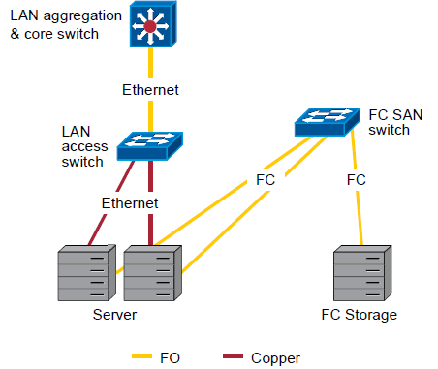
SAN – Storage Area Networks

Slide 22
Storage Solutions
The demand for storage capacities has been steadily growing as a result of increasing volumes of data as well as requirements for data backup and archiving. Cost efficiency in the area of company storage is therefore still a central theme for IT managers. Their goal is to achieve high storage efficiency by using their existing means and hardware in combination with storage virtualization, Cloud Storage (Storage as a Service) and consolidation.

Slide 23
Network Infrastructure Basics (NICs, Switches, Routers & Firewalls)
The components in a network infrastructure can basically be divided up into two groups:
· Passive network components which provide the physical network structure, such as cables (copper and glass fiber), outlets, distribution panels, cabinets, etc.
· Active network components, which process and forward (amplify, convert, distribute, filter, etc.) data.

Slide 24
NIC – Network Interface Card
A network interface card (NIC) usually exists “onboard” a network-compatible device and creates the physical connection to the network, by means of an appropriate access method. Ethernet in all its forms (different media and speeds) is currently being used almost exclusively as an access method, also known as a MAC protocol (Media Access Control).
Each NIC has a unique hardware address, also called a MAC address, that is required by switches in order to forward Ethernet frames. The first 3 bytes of this 6-byte MAC address is assigned by IEEE for the manufacturer, who uses the remaining 3 bytes as a serial number.

Slide 25
Repeaters and Hubs
These network components are not used much today, since, for reasons of performance, current LAN networks are constructed only to be switched. They were used as signal amplifiers (repeater) and distributors (hub) in shared Ethernets in which network subscribers still had to share overall bandwidth. Since these devices are rarely used today, we will omit a detailed description of them.

Slide 26
Switches
A “standard” layer 2 switch divides a network up into physical subnets and thus increases network bandwidth (from shared to switched). This means that each individual subscriber can now use the bandwidth commonly available to hubs, if the subscriber alone is connected to a switch port (segment).

Slide 27
Switches
Different switches can be distinguished based on their performance ability and other factors, by using the following features:
· Number of MAC addresses that can be stored (SAT table size)
· Method by which a received data packet is forwarded
(switching method)
· Latency (delay) of the data packets that are forwarded

Slide 28
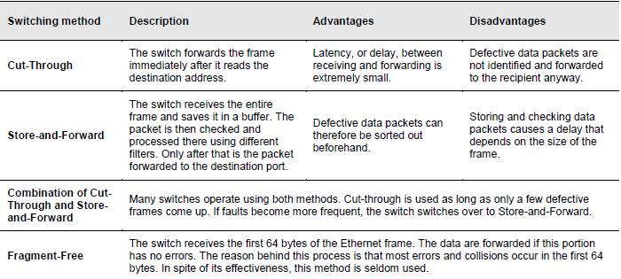
Switching methods

Slide 29
Router
A router connects a number of network segments, which may operate with different transmission protocols (LAN/WAN). It operates on Layer 3, the Network Layer of the OSI reference model.
As network nodes between two or more different networks or subnets, a router has an interface as well as an IP address in each network. It can therefore communicate within each of these networks. When a data packet reaches the router, the router reads its destination (destination IP address) to determine the appropriate interface and shortest path over which the packet will reach the destination network.

Slide 30
Load Balancing
Load balancing is a common data center application which can be implemented in large switching-routing engines.
One generally uses the term to mean server load balancing (SLB), a method used in network technology to distribute loads to multiple, separate hosts in the network. The load balancer serves different layers in the OSI model.
Server load balancing comes into use anywhere a great number of clients create a high density of requests and thus overload a single server. Typical criteria for determining a need for SLB include data rate, the number of clients and request rate.

Slide 31
Firewall
A firewall is a software component that is used to restrict access to the network on the basis of the address of the sender or destination and services used, up to OSI layer 7. The firewall monitors the data running through it and uses established rules to decide whether or not to let specific network packets through. In this way, the firewall attempts to stop illegal accesses to the network. A security vulnerability in the network can therefore be the basis for unauthorized actions to be performed on a host.

Slide 32
Firewall
Other firewall functions include intrusion detection and prevention (IDP), which checks the data transfer for abnormalities, as well as content/URL filtering, virus checking and spam filtering. High-end devices use these functions to check data transfers up to 30 Gbit/s.

Slide 33
Quick Review Question
Briefly explain the following:
a.DAS
b.NAS
c.SAN
Discuss the following:
a.Rack Server
b.Blade Server

Slide 34
Summary of Main Teaching Points
Discussed the roles and terminologies of servers and the various types of storage equipment.
Also discussed the issues surrounding low server utilization and the benefits of virtualization.

Slide 35
Question and Answer Session
Q & A

Slide 36
What we will cover next
Cooling System Options and Environmental Control

